Slide 1
Interim-Project Presentation Grow Big Programme : B. Tech in CSE
Mentor :Prof. Kishor
Group No. : 4
Team Leader : Abhishek S
Department : Computer Science

Slide 2
Project Team
Sl no. | Registration no. | Students
1 | 17ETCS002001 | A Ragaa Vardhini
2 | 17ETCS002004 | Abhilash Ramu
3 | 17ETCS002007 | Abhishek S
4 | 17ETCS002028 | Anusha K S

Slide 3
Outline
Title and Aim
Introduction
Motivation
Objectives
Methods and Methodology ( or Block Diagram)
Status of the Work
Results(Optional)
Expected Outcomes
Cost Estimation
Gantt Chart
References

Slide 4
Title: Grow Big A Progressive Web Application for Scaling Small business
Aim:
To Develop A Full Stack Progressive Web Application to connecting all small businesses at one place

Slide 5
Introduction
With an introduction “To Develop A Full Stack Progressive Web Application for Scaling Small business”
Since it is a business scaling application all the store can register here in one place so users can select stores and order or shops from their known nearby stores.
To make items and groceries shopping a bit convenient and easier, so we are working on it which ensure timely delivery of groceries and higher money saving benefits and help small business.
Customers can get easily from where they are getting items and return as soon as possible.

Slide 6
Motivation
Maintenance of the quality of the item and satisfy the customer requirements
Delivering product on time
Increased changes of surfing things you want as there are multiple stores at a single location.
To provide transparency in purchasing items from where, quality and freshness of items, easy and fast returns.

Slide 7
Objectives
To conduct literature survey on scaling business systems
To analyze survey and collect requirements.
To Design & develop front-end user interface based on requirements
To Implement server side work develop Back-end to provide data to clients.
To develop PWA: Progressive Web Application for installation purpose.
To test developed application on local system.
To host live using appropriate service for usage purpose

Slide 8
Methods and Methodology /Block Diagram
1. To conduct literature survey on scaling business systems:
1.1: Conducted literature survey based on our business scaling application by referring some of existing application.
1.2: There are many grocery & Items ordering systems but not helpful for all small businesses and we want to help them to grow with us.
2. To analyze survey and collect requirements.
2.1: Based on information gathered and as per our application need requirements are collected.
2.2: User should be able to create account for their store and login.
2.3: System should show all the registered stores in home page.
2.4: Customer should be able to search stores and be able to order from their known surrounding particular store.

Slide 9
Methods and Methodology /Block Diagram
3. To Design & develop front-end user interface based on requirements:
3.1: As per requirements, need to develop front-end using appropriate technologies.
3.2: HTML,CSS for front-end portion and adding styles and javascript scripting language to make the site interactive for the user and to add useful functionalities.
3.3: Bootstrap to add inbuilt CSS components and styles. It also contains come basic components that we can directly use by copying code.
3.4: Bothe Business user and customer type user can log in and signup
3.5: Business user goes to their home page and able to add store items and details of their store and able to edit them
3.5: Customer type users able to see all the stores details along with

Slide 10
Methods and Methodology /Block Diagram
- all the items and can search for particular items or store and can add
To their collections and can remove from collections.
3.6: Customers can also able to place order with flexible delivery time only if they are logged in.
3.7: All the orders placed from particular stores goes to specific store site and indicates number of order came from users.
4. To Implement server side work develop Back-end to provide data to clients:
4.1: To store data, give back to client and calculation on server side have to choose appropriate back-end tools and frameworks.
4.2: Node.js helps to write java-script and run on server side.

Slide 11
Methods and Methodology /Block Diagram
4.3:Express.js is a Nodejs web application server framework, It has become the standard server framework for node.js.
4.4: EJS (Embedded Java-script) is used for templating purpose, adds dynamic pages and helps to display stored data through ejs tags.
4.5: MongoDB The standard NoSQL database for flexibility and ease of usage.
4.6: Passport.js, passport-local for authentication and security
4.7: All the users details are stored in User collection and store items in List collection & Cart collection under one database
4.8: Passport checks and verifies new users while logging in and signup
only new user can signup

Slide 12
Methods and Methodology /Block Diagram
4.9: And also checks respective users password from the database and encrypts the users password.
5. To develop PWA: Progressive Web Application for installation purpose.
5.1: Progressive Web Application which can be installed directly from browser and works same as native apps.
5.2: Users can install the website and it will work as native apps
6. To test developed application on local system.
6.1: After development testing on local host by trying to access all the features and testing of database access.

Slide 13
Methods and Methodology /Block Diagram
6.2: Try to search stores and try to login and signup and checking the database that we are able to maintain proper user data.
7. To host live using appropriate service for usage purpose:
7.1: Purchase domain and hosting live website by choosing appropriate services.
7.2: Host the live website for use.

Slide 14
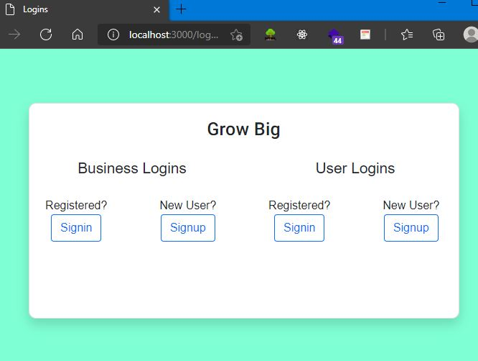
Results
User logins for both types

Slide 15
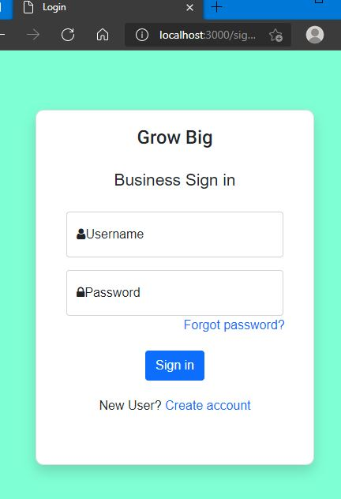
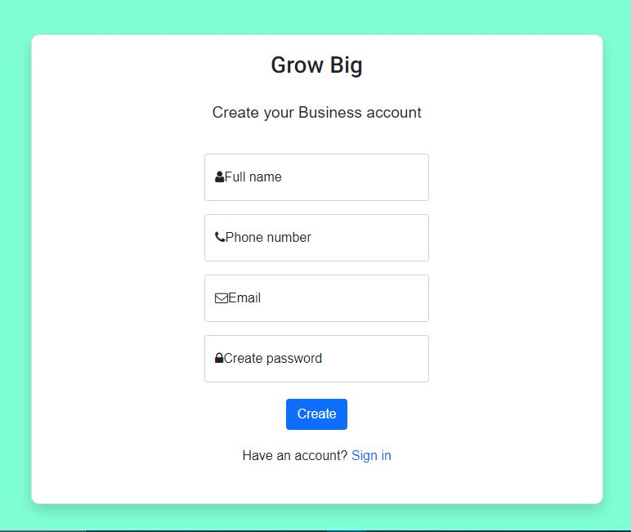
Results
Business user sign-in page
Create account page

Slide 16
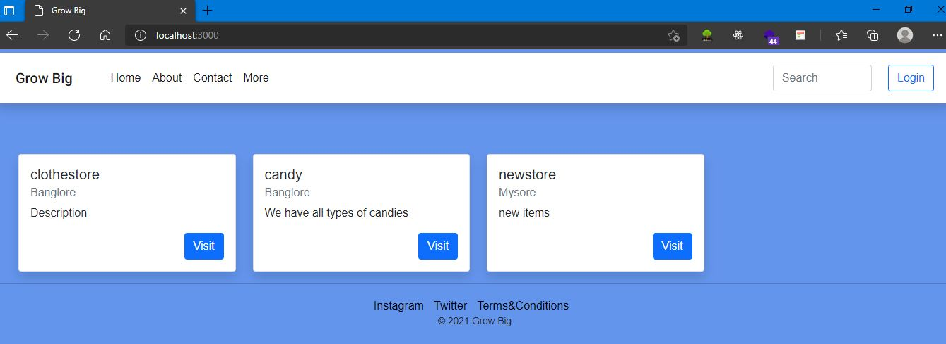
Results
Homepage displaying the stores added by Business user

Slide 17
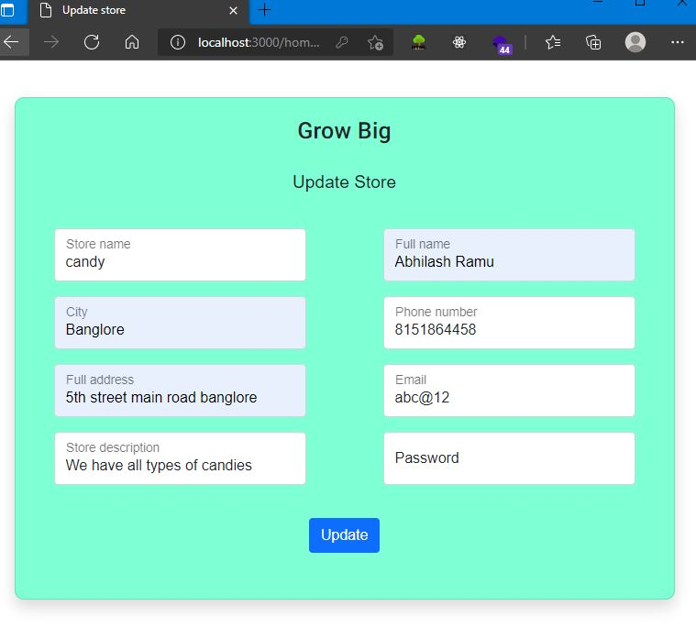
Results
After signup user enters here to update store details etc.

Slide 18
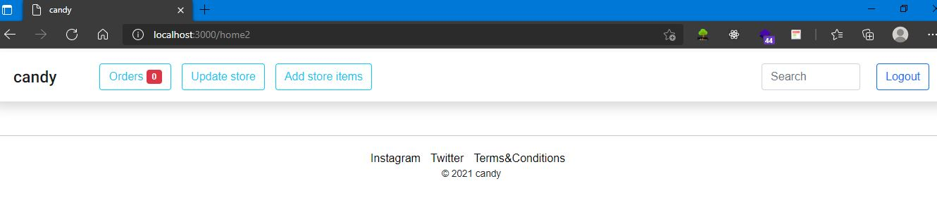
Results
After updating details users will see their home page

Slide 19
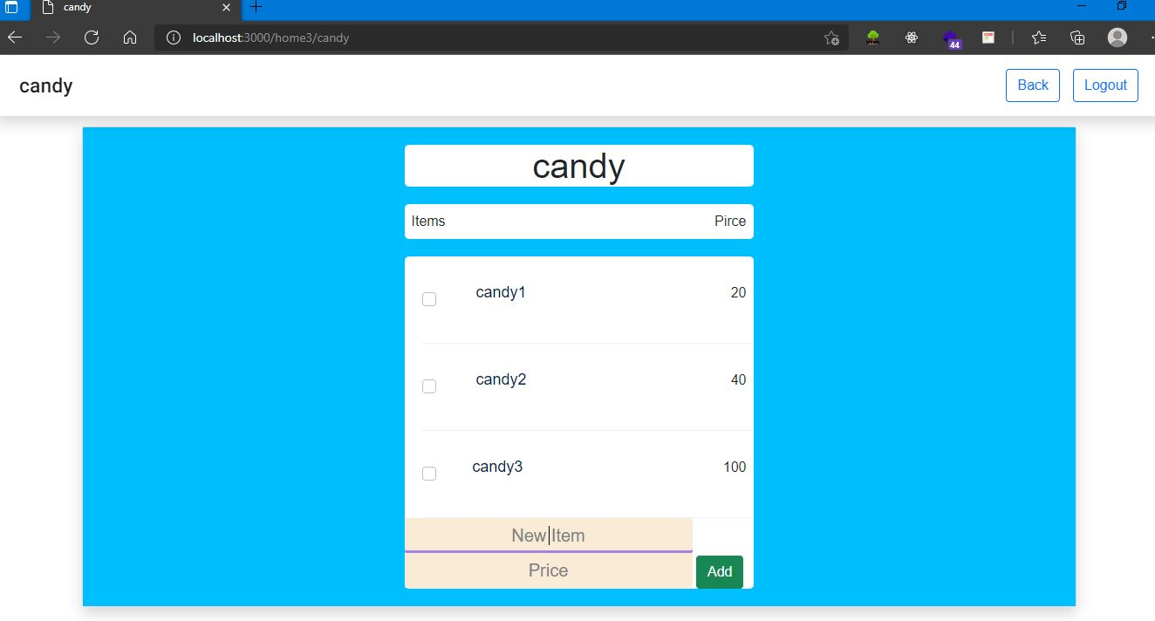
Results
A page where user can add items to their store and deletes

Slide 20
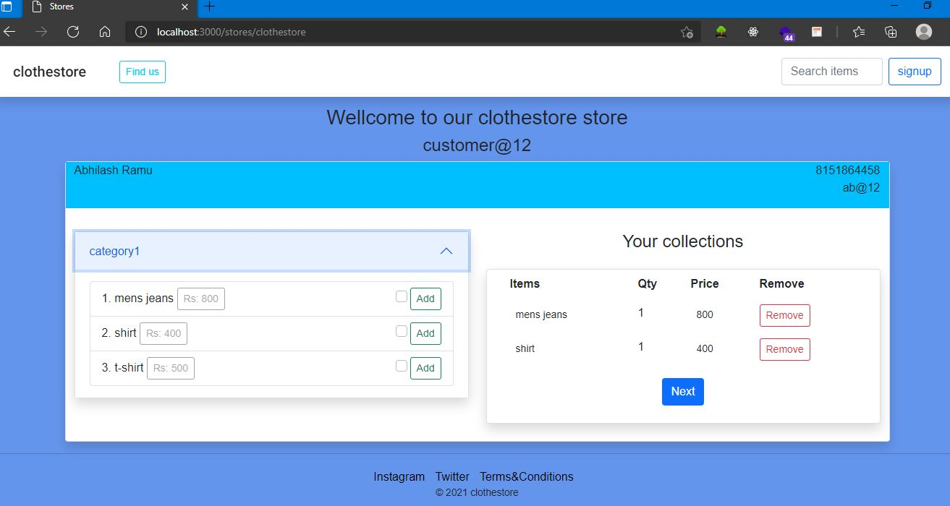
Results
Individual stores looks like this

Slide 21
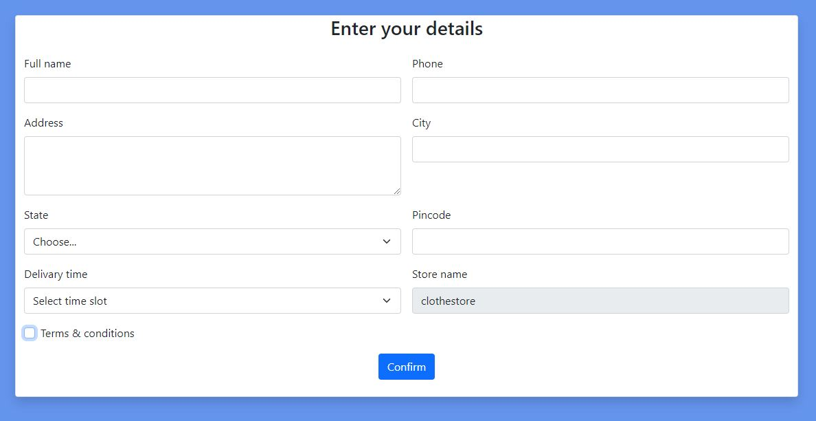
Results
After selecting items entering details for shipment

Slide 22
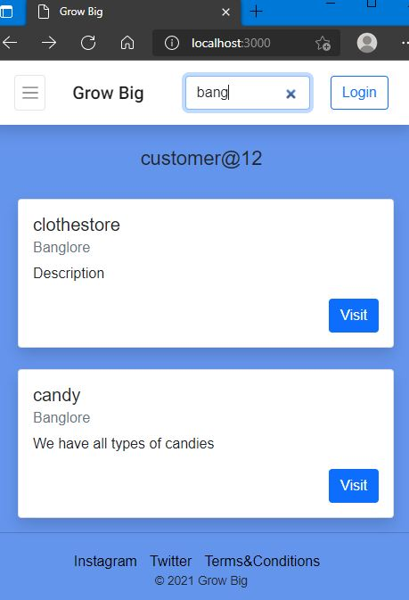
Results
Searching for particular location or stores

Slide 23
Cost Estimation
S.No. | Particulars/Components/Devices | Estimated Cost(Rs)
1 | Web Hosting | 200/mo=2400/yr
2 | Domain Purchase | 800/yr
 | Total: | 3200/yr
Man hours:
Man hours per week (students): 18 *4 students =72
Man hours per week (faculty): 3

Slide 24
Gantt Chart
Week | 1 | 2 | 3 | 4 | 5 | 6 | 7 | 8 | 9 | 10 | 11 | 12
Major activities
Literature survey
Web design
Frontend development
Backend development
Report submission and documentation

Slide 25
Gantt Chart
MEMBERS | RAAGAVARDINI |  | ABHILASH |  | ABHISHEK |  | ANUSHA
Major activities
Literature survey
Web design
Frontend development
Backend development
Report submission and documentation

Slide 26
References
Binayak Panda , Pradeepta Kumar Panigrahi,2012 , April .A Model for Small Scale Website Development Gandhi Institute of Engineering & Technology ,Gunupur ,Orissa ,India. IJCST Vol.3,Issue 2,April –June 2012
Chai Lee Goi,“The impact of website development on organisation performance: Malaysia’s perspective”, African Journal of Business Management Vol. 6(7), 22, pp. 2435-2448, 2012.
San Murugesan, Yogesh Deshpande, Steve Hansen and Athula Ginige,“Web Engineering: A New Discipline for Development of Web-based Systems”,WebISM (Web-based Information Systems and Methodologies) Research Group, Campbelltown, Australia.

Slide 27
Thank You

